Slide 1


DEVIN AI SOFTWARE ENGINEER
Exploring the Power of Artificial Intelligence
SRI SIDDHARTHA ACADEMY OF HIGHER EDUCATION
(DEEMED TO BE UNIVERSITY)
Accredited A⁺ Grade by NAAC
SRI SIDDHARTHA INSTITUTE OF TECHNOLOGY
(A Constituent College of SSAHE)
Maralur, Kunigal Road, TUMAKURU-572105
DEPARTMENT OF MASTER OF COMPUTER APPLICATIONS
2023 – 24
TECHNICAL SEMINAR-I
Presented by :
Mr. KOUSHIK T N
23MCA26
I Semester, MCA
SSIT, Tumakuru

Slide 2
Agenda
Introduction to Devin AI
Evolution of Artificial Intelligence
Applications of Devin AI
How Devin AI Works
Benefits and Challenges
Reference

Slide 3
Introduction to Devin AI
Definition of Devin AI
A software engineer-like AI that can code, debug, and develop apps and websites.
History and development
  Launched on12-03-2024
  Cognition under the leadership of Scott Wu

Slide 4
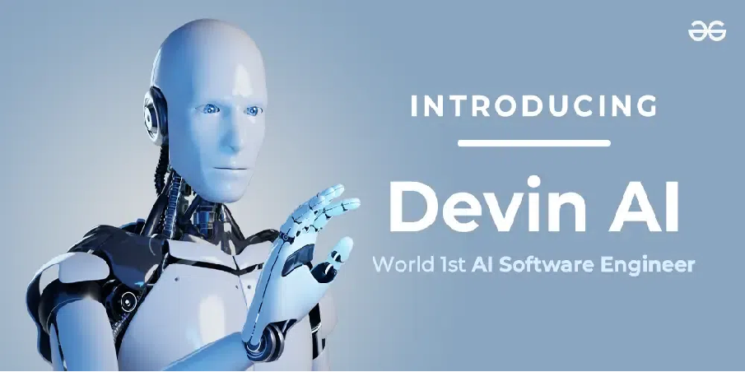

Slide 5
Evolution of Artificial Intelligence
Early Ideas (1950s)
AI in Everyday Life (Present)
Overview of AI evolution from rule-based systems to deep learning
Key milestones in AI development

Slide 6
Applications of Devin AI
Healthcare: Diagnosis, personalized treatment plans
Finance: Fraud detection, risk assessment
Customer Service: Chatbots, virtual assistants
Manufacturing: Predictive maintenance, quality control
Education: Adaptive learning, student support

Slide 7
Is it released?
Devin AI is currently not released for public use.
It is in the beta testing phase and available to select users in a limited capacity.
Cognition may offer Devin through a paid service or limited access program initially.
If you are interested in using Devin, you can request early access by filling out the Google form available on their website or by emailing them.

Slide 8
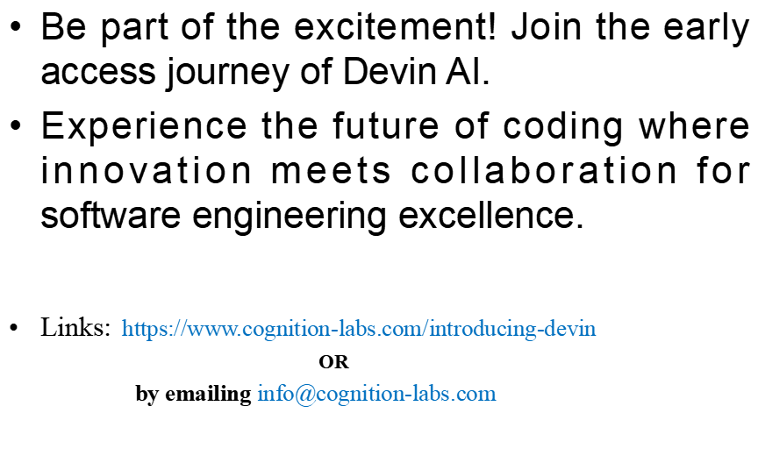
Join Early Access

Slide 9
How Devin AI Works
Devin AI likely works through a combination of machine learning models, natural language processing (NLP) techniques, and possibly other AI methods.
Data collection, preprocessing, training, and testing phases

Slide 10
Benefits of Devin AI
Increased efficiency and productivity
Improved decision-making
Enhanced customer experience
Automation of repetitive tasks

Slide 11
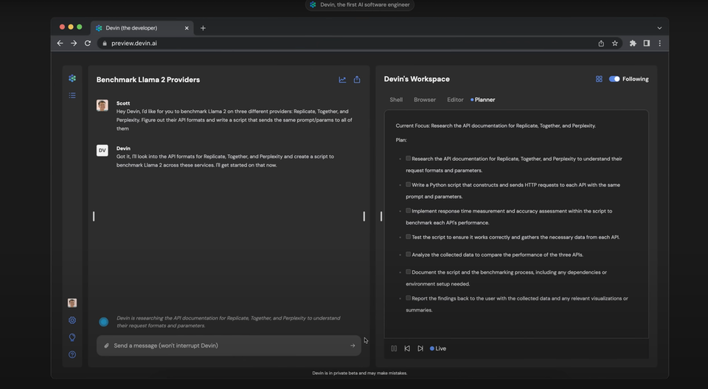
Workspace
making plan

Slide 12
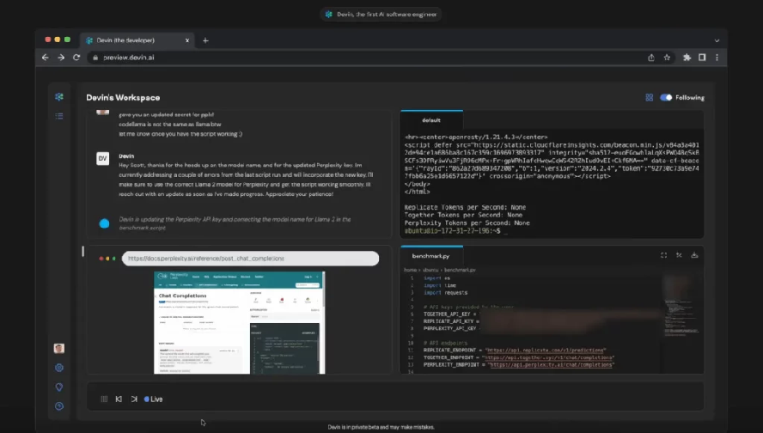

Key Features of DEVIN AI
Browser
Text Editor
devin runs unexpected errors

Slide 13
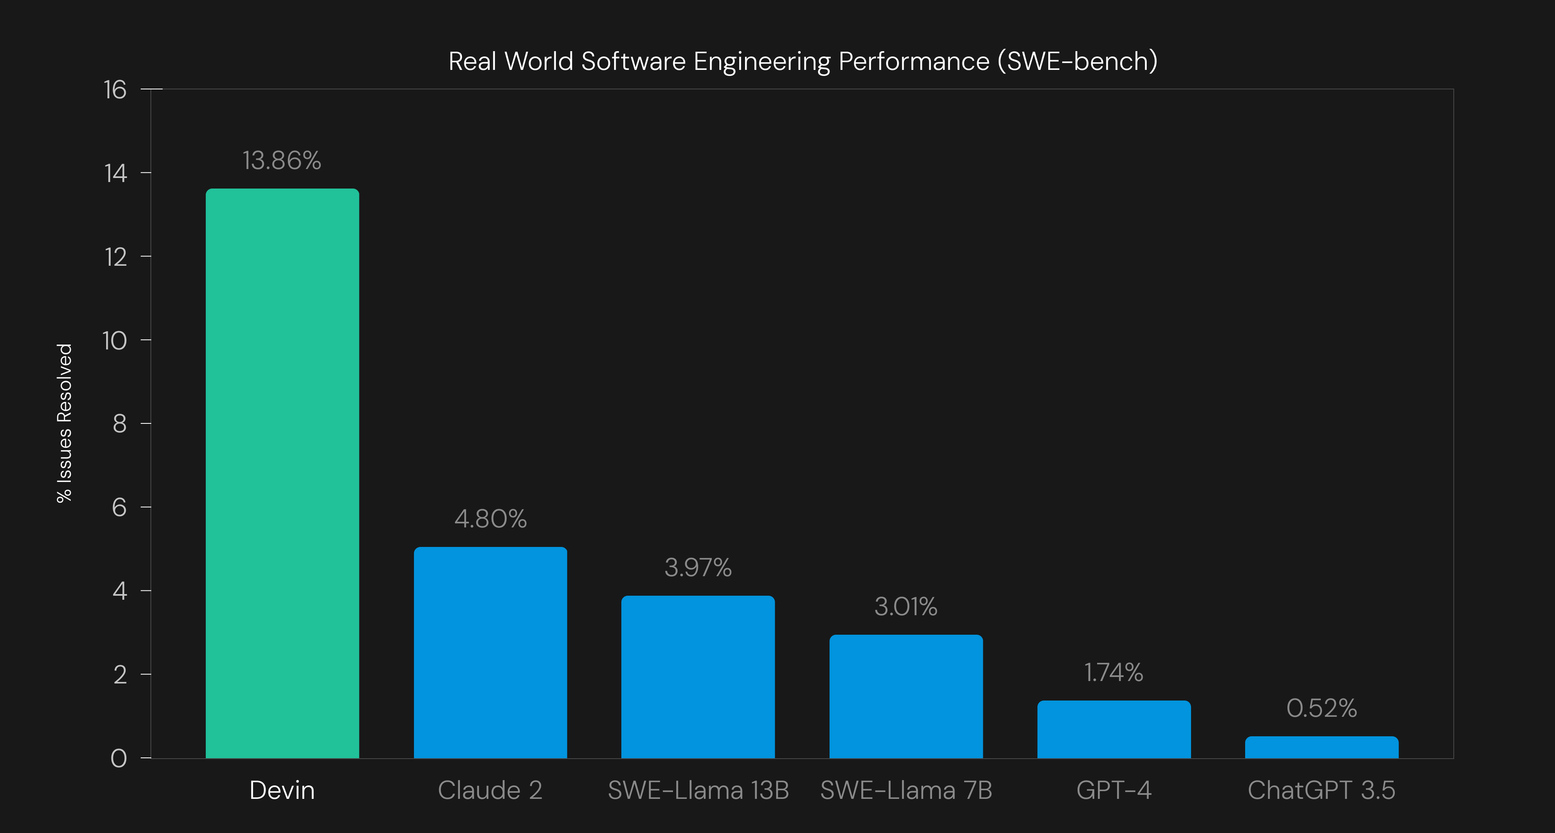
Devin's Performance

Slide 14
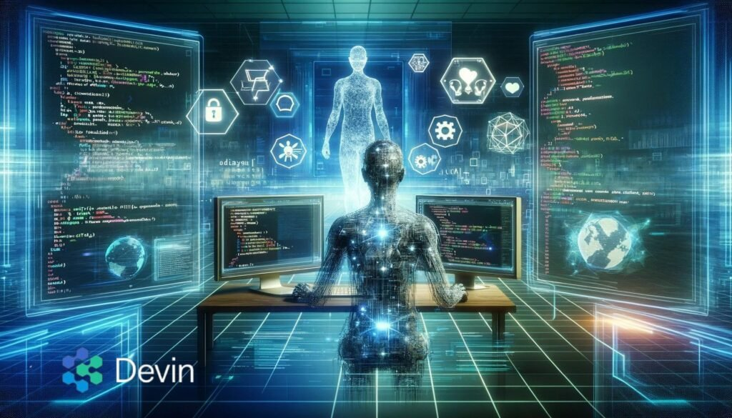
Reference
https://www.cognition-labs.com/

Slide 15



